Slide 1
Please sit with your group!
Pink group = Dataset 1
Achour Amiri
Liza DeGenring
Isabella Borrero
Mustafa Jibrin
Anissa Poleatewich
Sanjib Sapkota
Meinan Wang
Baylee Voigt
Yellow group = Dataset 2
Arild Arifin
Kathryn Duris
Blaise Jumbam
Adele McLeod
Dinesh Poudel
Shankar Shakya
Edgar Nieto-Lopez
Orange group = Dataset 3
Green group = Dataset 4
M. Amina Hassani
Bisho Lawaju
Afsana Noor
Mandeep Redhu
Shan Shan
Iris Goet
Jordan Marshall
Pragyan Burlakoti
Shashika Hewavitharana
Mihir Mandal
Dipiza Oli
Samantha Rude
Alexander Tako
Carla Tavares

Slide 2
Learning Basic Metagenomic Tools for Disease Diagnostics and Microbiome Analysis
Hannah Toth, Graduate student, Ohio State University
Dr. Veronica Roman-Reyna, Assistant Professor, Penn State University
Dr. Marcus Merfa, Post-Doctoral Scholar, Ohio State University
Dr. Jonathan Jacobs, Associate Professor, Ohio State University

Slide 3
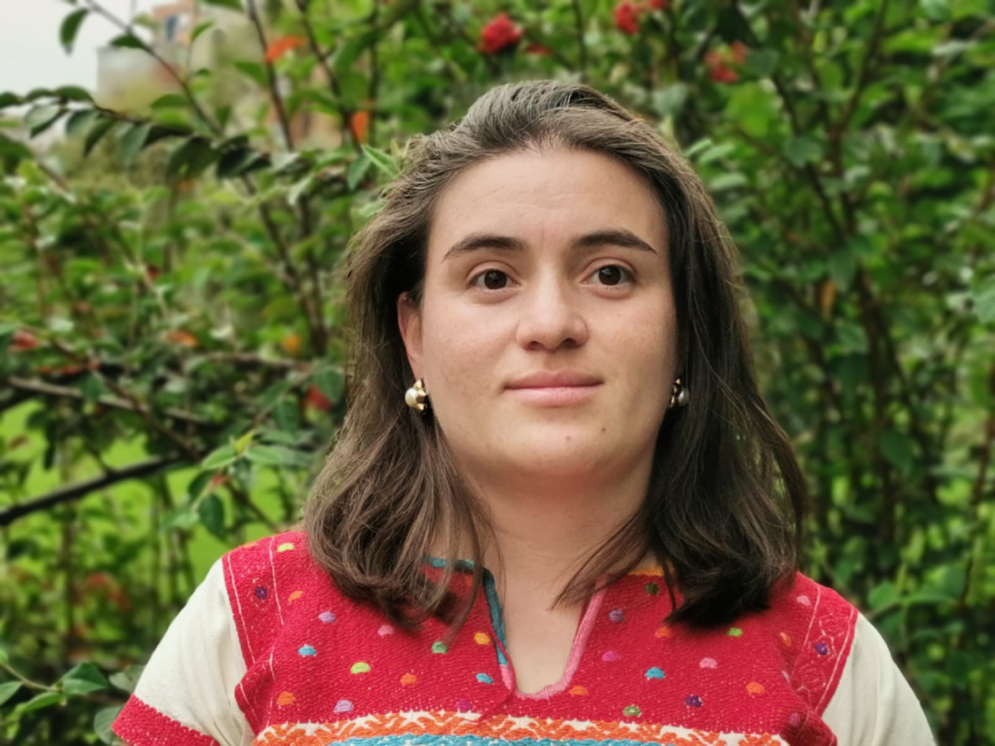

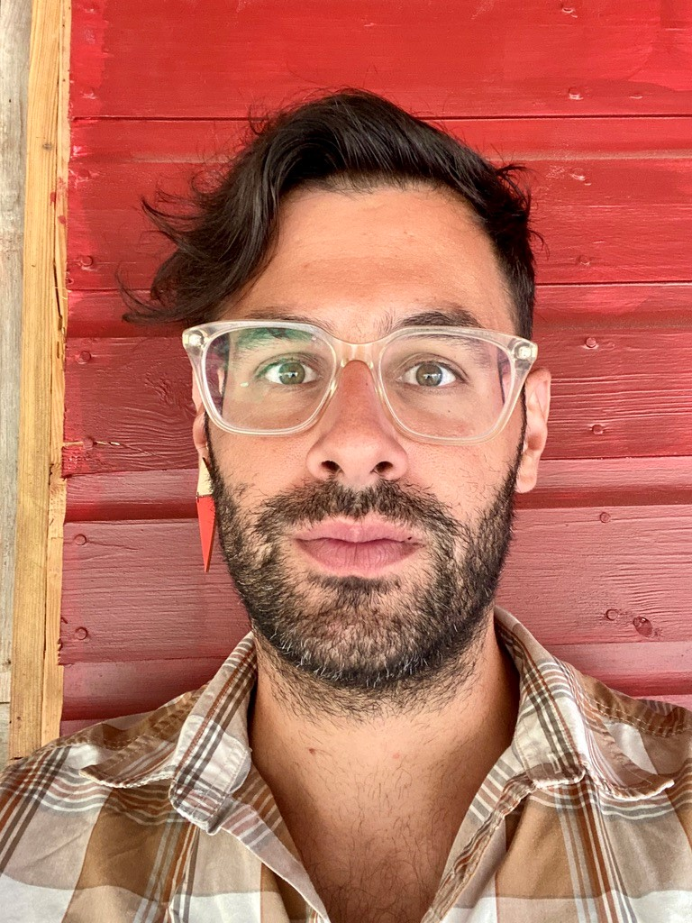
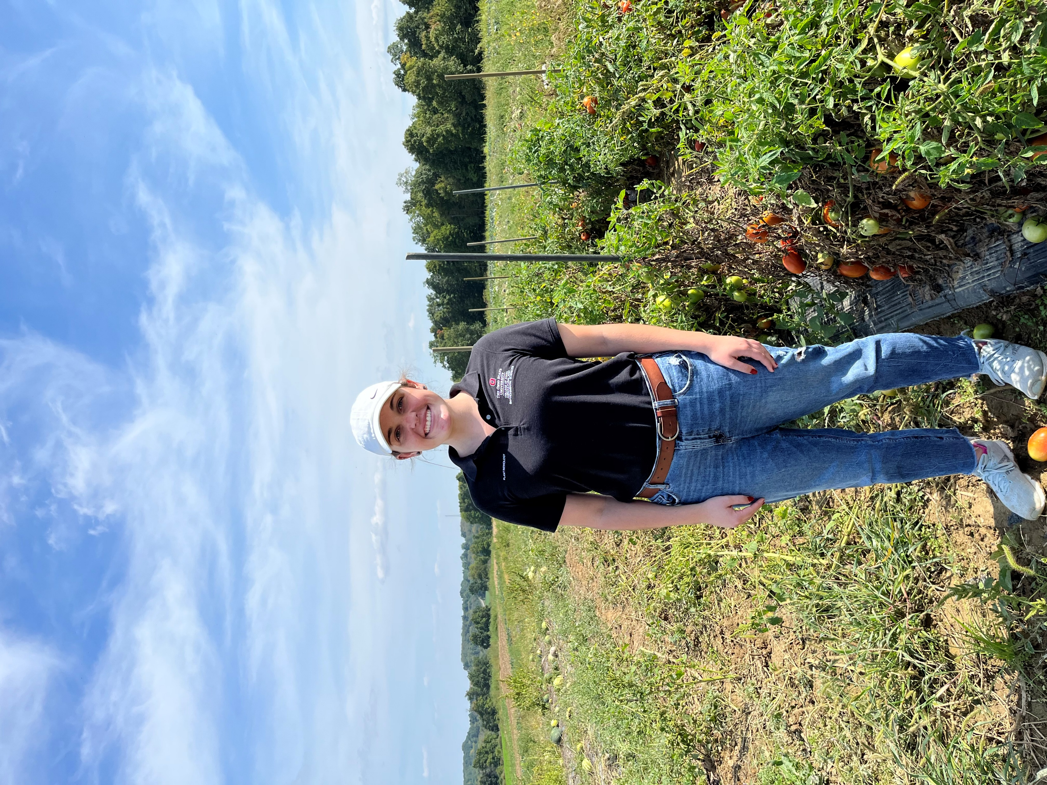
About us!
Hannah Toth
Graduate student
The Ohio State University
Advised by Dr. Jonathan Jacobs
Dr. Veronica Roman-Reyna
Assistant Professor
Pennsylvania State University
Dr. Marcus Merfa
Post-Doctoral fellow
The Ohio State University
Dr. Jonathan Jacobs
Associate Professor
The Ohio State University

Slide 4
Course objectives
I assigned you a color when you came in, and now you’re seated with other people assigned to the same color.
Your color is assigned to a dataset, 1-4. It is your job to figure out the causal agent in your dataset!
You will use a variety of programs (mostly) on the Ohio Supercomputer (OSC) to conduct your analysis.

Slide 5
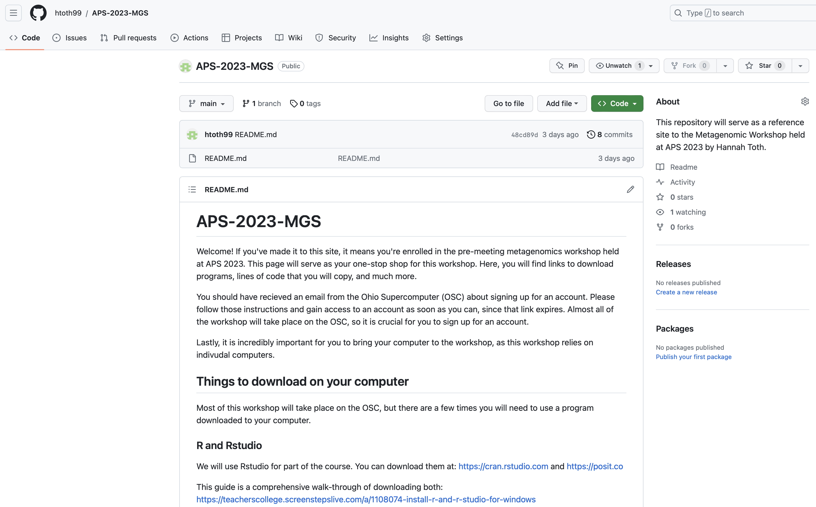
Notes:
This is a great tool for today and after today as well. I will be uploading my slides on here, any information you’d like to me to that I mentioned, and links to all the programs we use today. I will not be uploading your dataset as that is research information that we own. Furthermore, after today your access to OSC will be revoked as access was only given so you could participate in workshop.

Slide 6
Course structure
Module 1: Overview and metagenomic basics
Module 2: Transforming raw data into assembled genomes
Module 3: Analysis of metagenomic data and genomes
Module 4: Metagenomics for research

Slide 7
Except… science isn’t linear
Module 2: Transforming raw data into assembled genomes
Module 2: Transforming raw data into assembled genomes
Module 3: Analysis of metagenomic data and genomes
Module 1: Overview and metagenomic basics
Module 3: Analysis of metagenomic data and genomes
Module 4: Metagenomics for research
Module 4: Metagenomics for research
Module 4: Metagenomics for research
Notes:
If this is confusing, I’ve broken it down in a way that will make sense at the end of the day!

Slide 8







What is metagenomics?
According to the National Human Genome Research Institute, metagenomics is defined as “the study of the structure and function of entire nucleotide sequences isolated and analyzed from all the organisms (typically microbes) in a bulk sample.”
What does that mean in the world of plant pathology?
Notes:
Human gut microbiome. Can study the ecology and plant-microbe and microbe microbe interactions

Slide 9
Why use metagenomics?
Emerging or novel pathogens
Epidemic preparedness
Co-infections
Seed certifications
Metagenomics tells researchers the entire microbial community in the sample – which is incredibly beneficial when other methods do not have that same ability
Notes:
What were the needs? What was the problem and how does MGS provide a solution?
why use in plant pathology?
put up pictures of papers

Slide 10


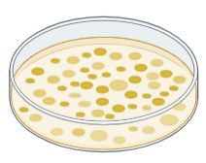

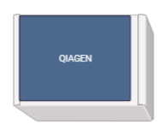
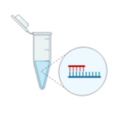
MGS pipeline is a bit easier than you might think!
Culturing typically tries to emphasize or look at one particular pathogen, while metagenomics looks at the entire community.
It’s important to note that when we do MGS analysis, we do not look at the plant DNA. Rather, we look at the microbial community within the plant tissue.

Slide 11
Sequencing: short-read and long-read sequences
Contig: A continuous set of overlapping DNA segments that provide a representation of a genomic region
Short-read sequences
Short-read sequences have small gaps between their contigs, while long-read sequences make up for these gaps, as denoted by the red dashes. These regions are made up of repetitive elements.
Contig 1
Contig 2
Contig 3
Long-read sequences
Contig 1
Complete Genome

Slide 12
S is for sequencing
Sequencing bridges the gap between your clear liquid in a DNA tube and the actual nucleotides that make your fragment or genome.
In the Jacobs Lab, we use short-read sequencing for all metagenomic sequencing. Specifically, we use the Illumina iseq100 and NextSeq2000 machines to sequence our metagenomic data.
Long-read sequencing technology, such as Nanopore, for MGS is possible and is used by many!
The programs we will use today are short-read sequencing based, and therefore, different programs will be needed for long-read MGS data.
Notes:
Maybe split into 2 slides
short and long are pieces of puzzle

Slide 13
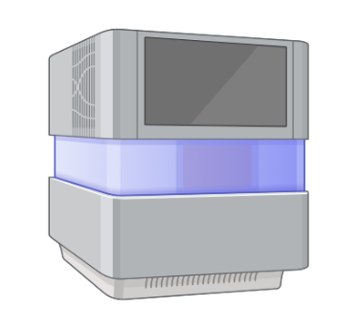
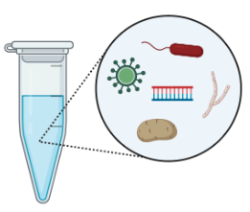
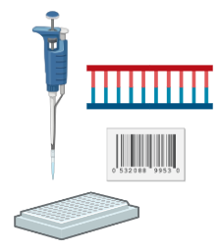
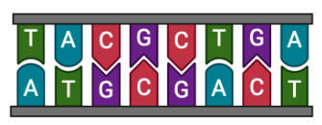

DNA is extracted, now what?
R1
5’
3’
3’
5’
R2
Total DNA from sample
Library preparation
Raw data files:
R1 and R2
Sequencer
Notes:
File is scary – it’s okay that it’s scary.
amount of DNA needed in DNA extracted sample
Explain R1 and R2 more, forward and backwards don't make much sense. Maybe remove sample fastq file?
Have a pipeline after this slide and explain what the datasets are at right now and then where they will be

Slide 14




Ohio Supercomputer Center (OSC)
Large computing capacity
Abundant data storage
Financially advantageous

Slide 15
At this time, please take out your laptop
Take out your laptop, connect to the Wifi, get yourself situated

